Slide 1

External Secrets Operator
A Cloud Native way to manage your secrets
KubeHuddle Toronto 2023
@sebagomez

Slide 2
Little poll
🙋

Slide 3
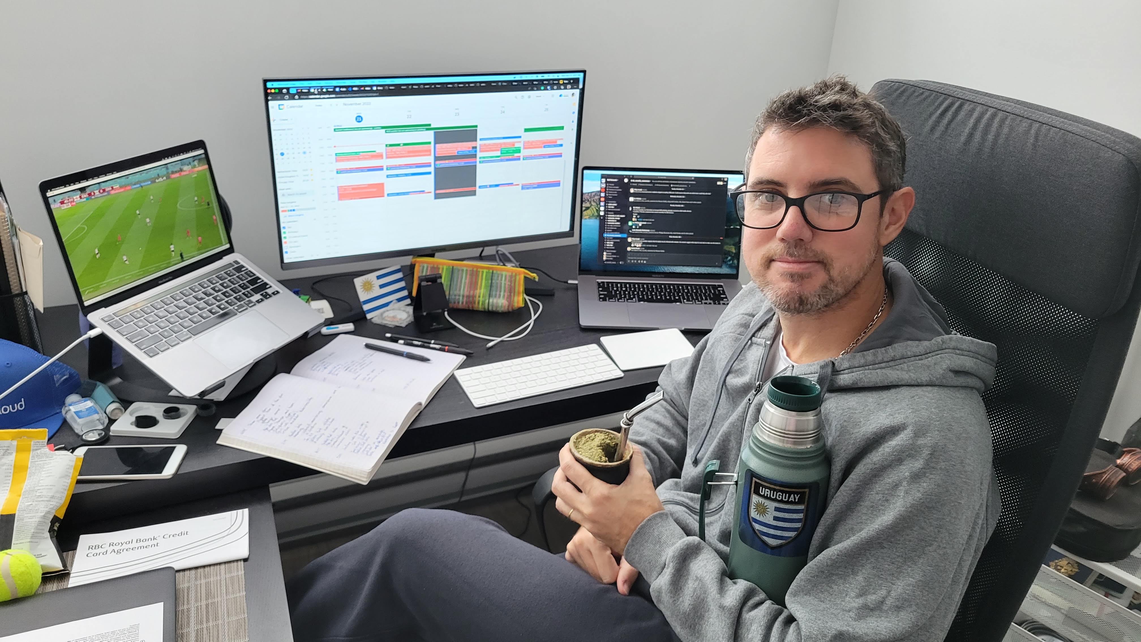


Who am I?
Sebastián Gómez (seb)
Online Programmer (Software Engineer) at Ubisoft
Dev background with some Ops
Automate everything I can
Maintainer of External Secrets Operator

Slide 4

Disclaimer

Slide 5
The problem

Slide 6
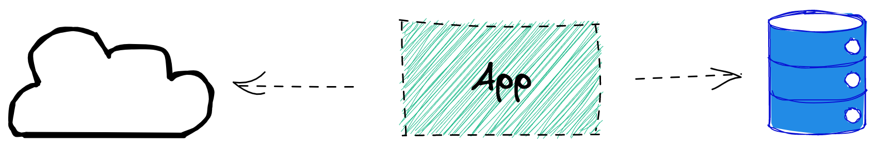


Slide 7
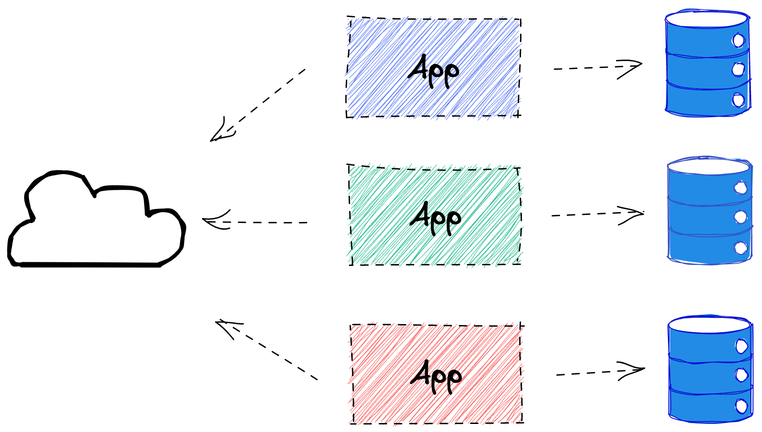

Slide 8
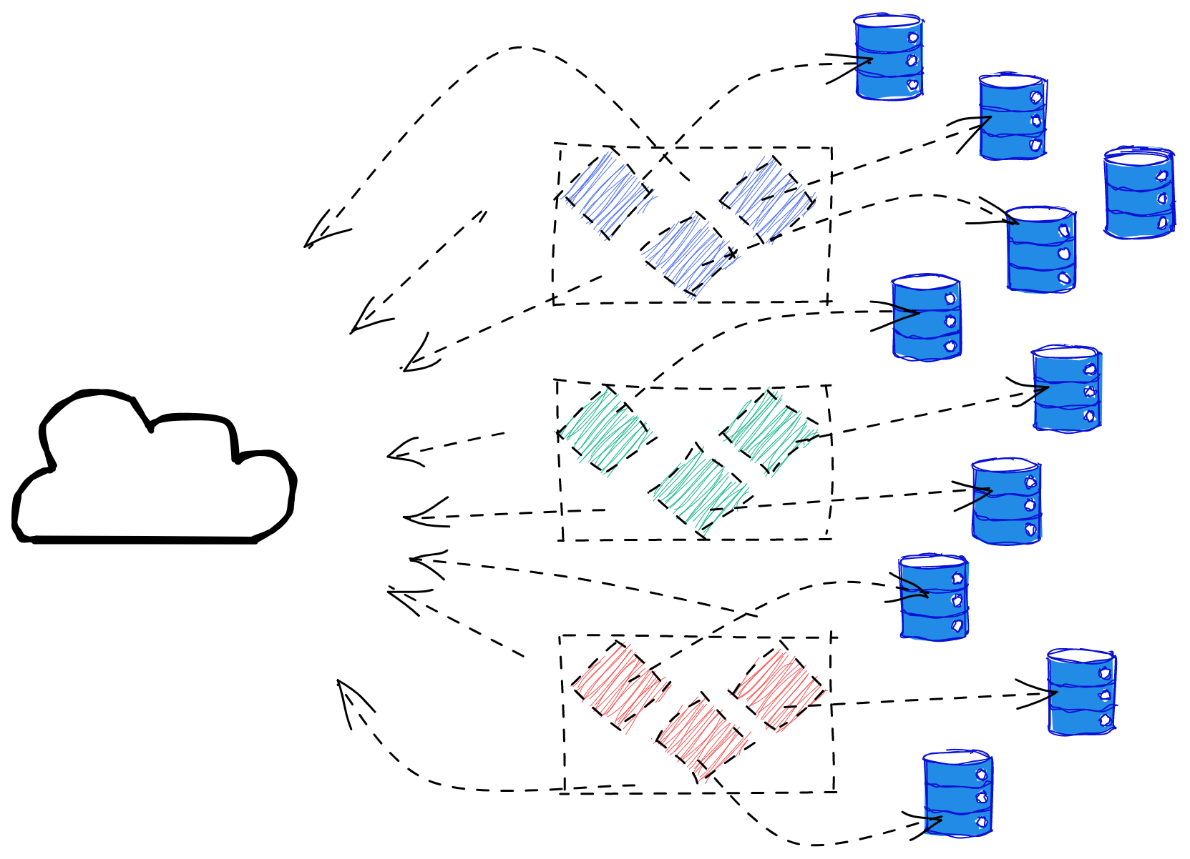

Slide 9
The problem
Challenges in a multi service and multi environment setup in K8s
You can end up with hundreds of secrets to manage
Hard to handle rotation
Hard to onboard new services
Hard to onboard new people with specific accesses
Where do we store them?
How do we distribute them securely? Copy & paste? 🤮

Slide 10


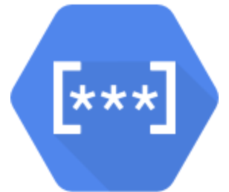



The solution (part of)
Cloud Secret Managers
Hashicorp Vault
AWS Secrets Manager
Google Secrets Manager
IBM Cloud Secrets Manager
Oracle Key Vault
Azure Key Vault

Slide 11
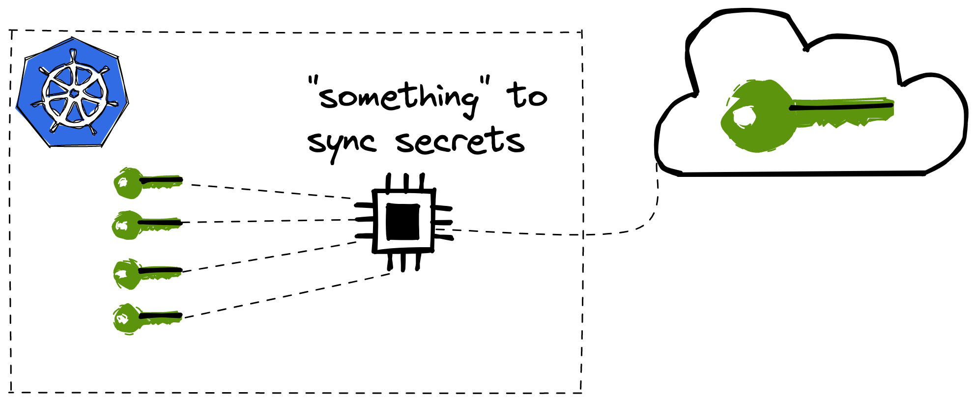
The solution (best part)

Slide 12
The solution
The appeal for syncing secrets
AWS, Azure, GCP can be used with other services
Use features from providers (encryption at rest, easier rotation, etc)
Declare secrets in source code
Avoid access to actual secrets

Slide 13
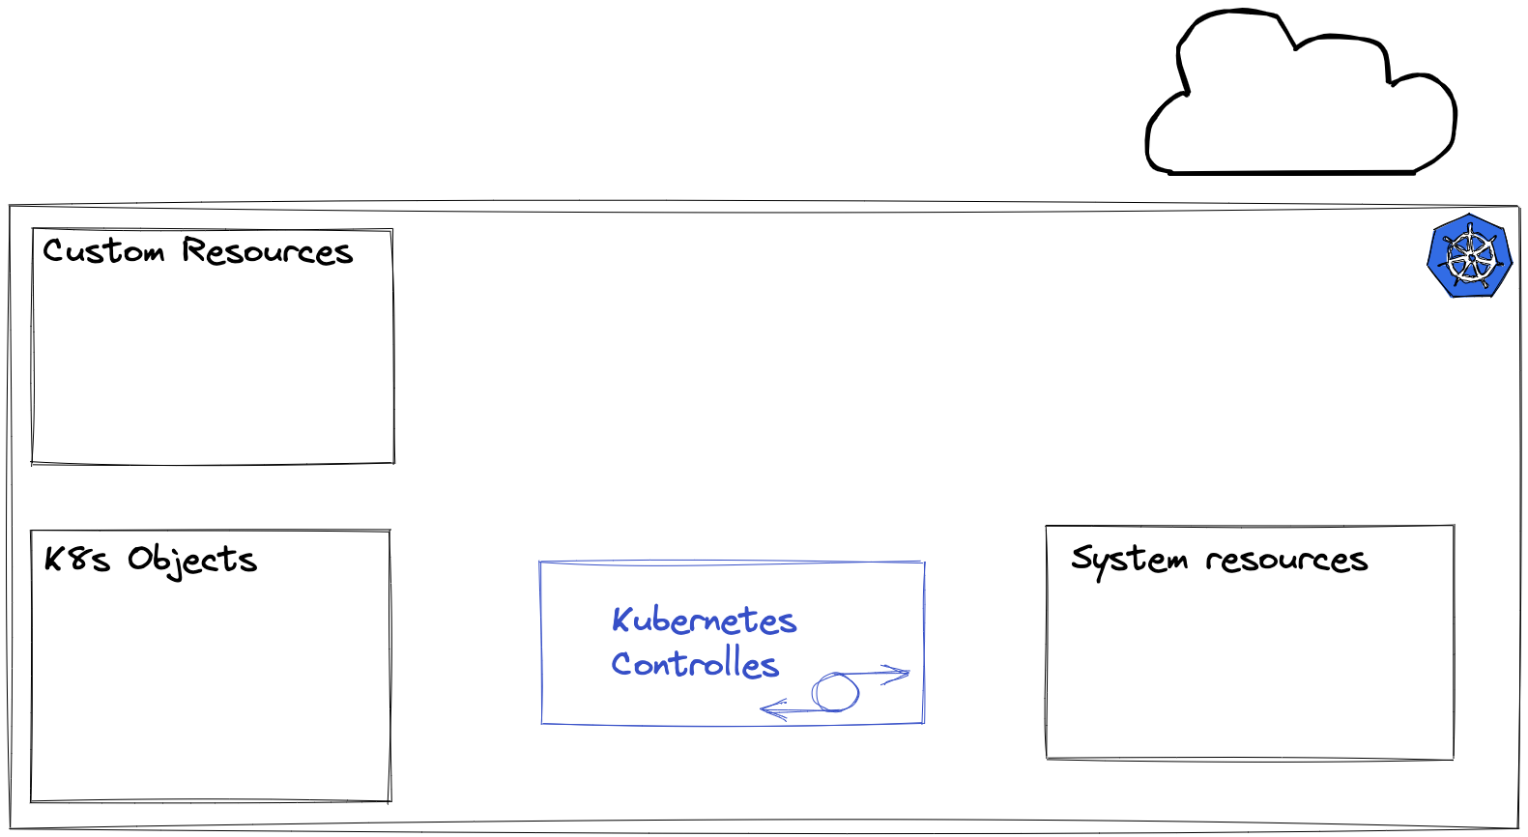

Slide 14
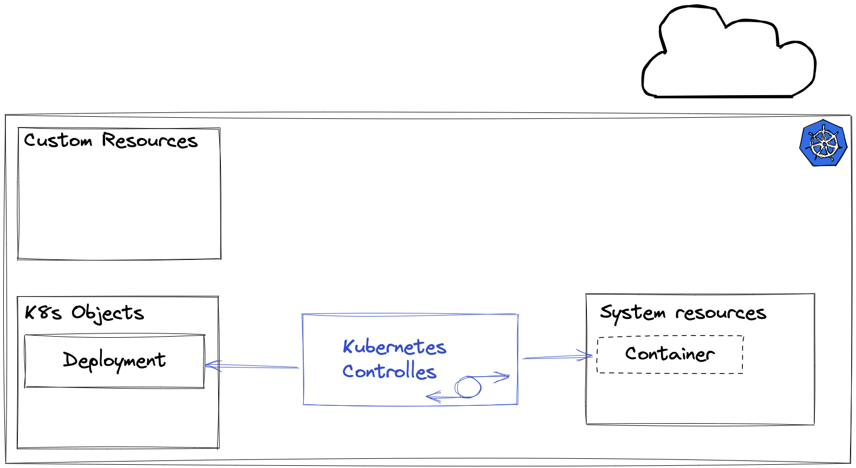

Slide 15
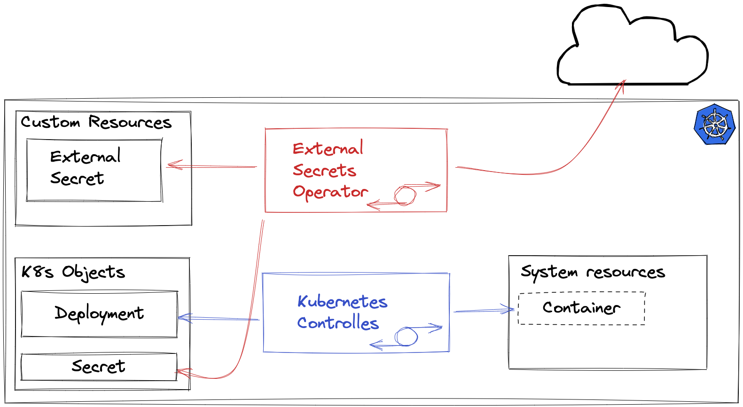

Slide 16
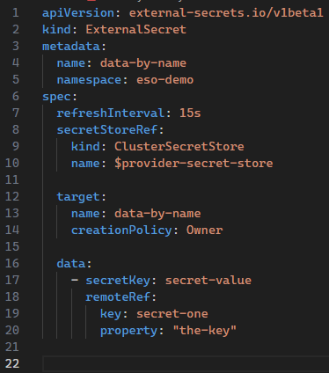
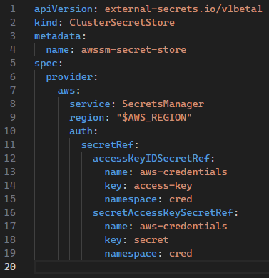

Slide 17
Demo time
🤞

Slide 18
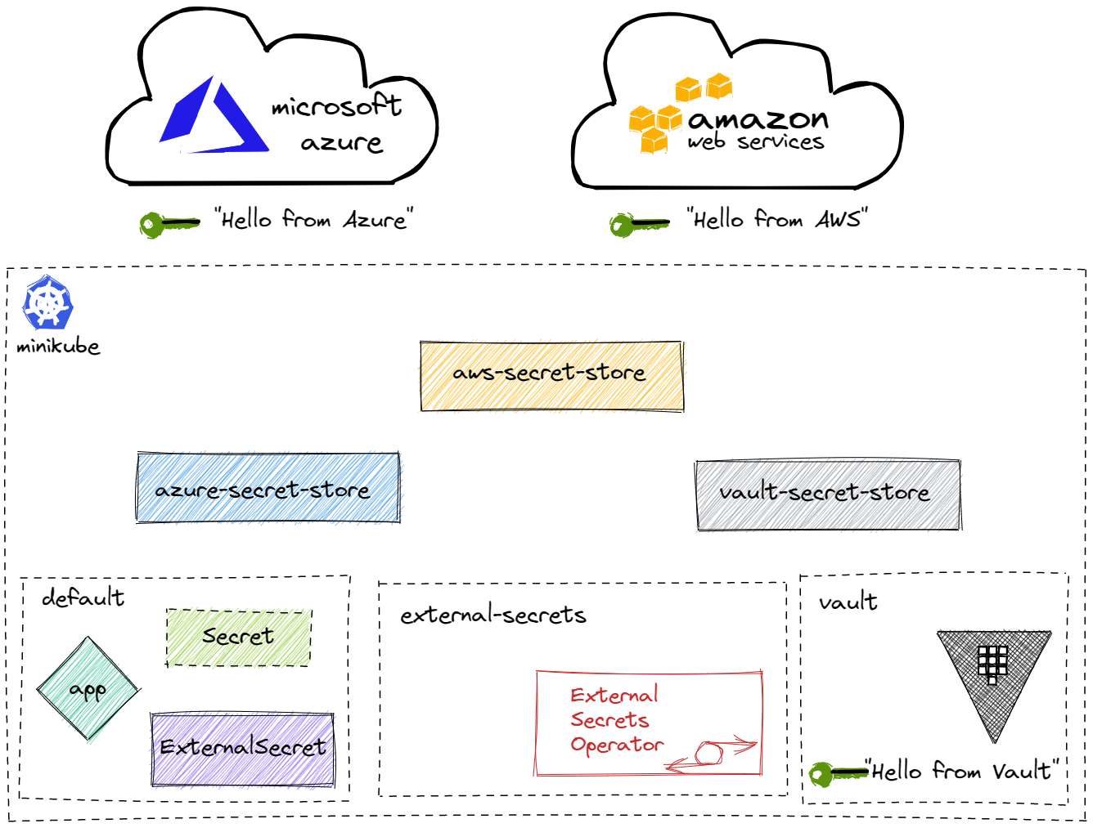


Slide 19
State of the art
(or stuff I didn’t have time to demo)
PushSecret allows to sync and backup
Generators
ACRAccessToken
ECRAuthorizationToken
GCRAccessToken
VaultDynamicSecret
CNCF Sandbox

Slide 20
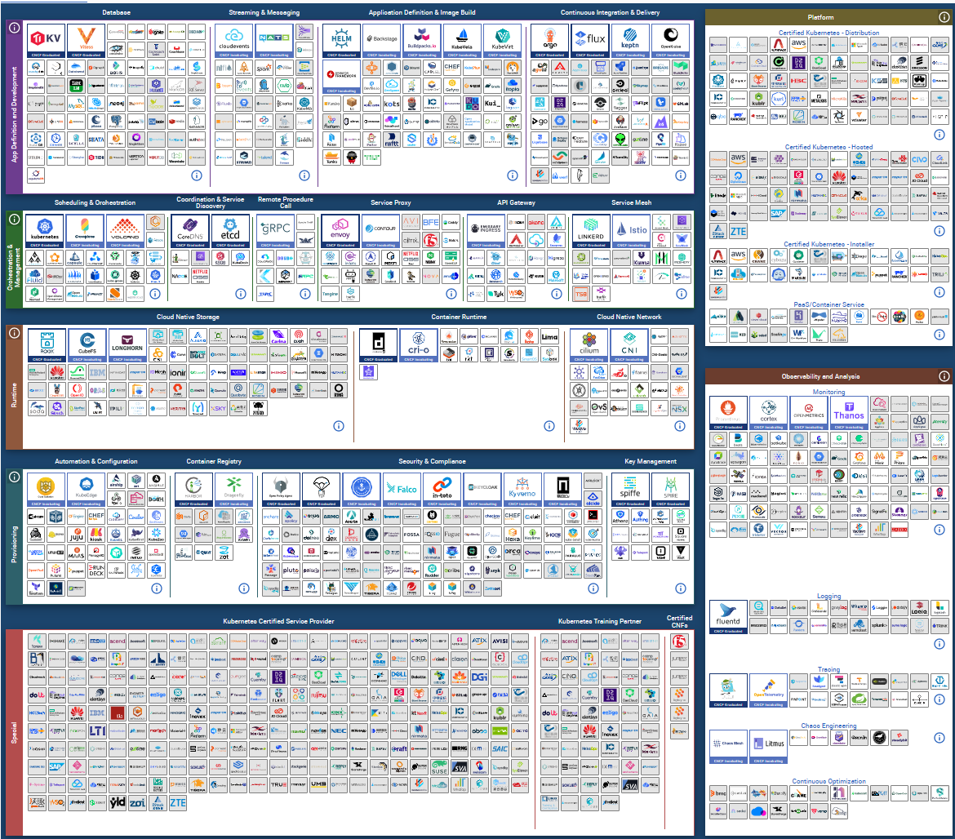

Slide 21
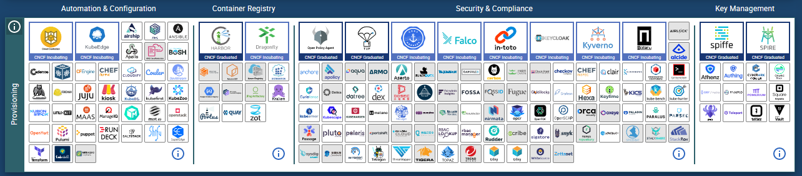

Slide 22
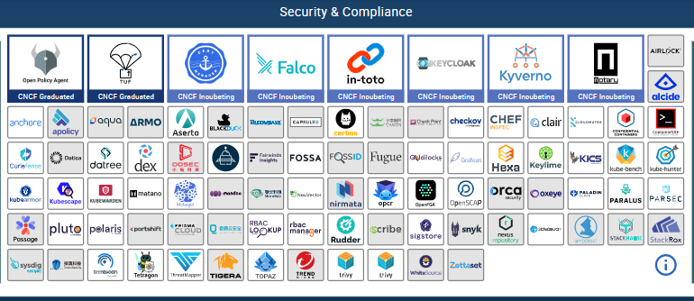

Slide 23
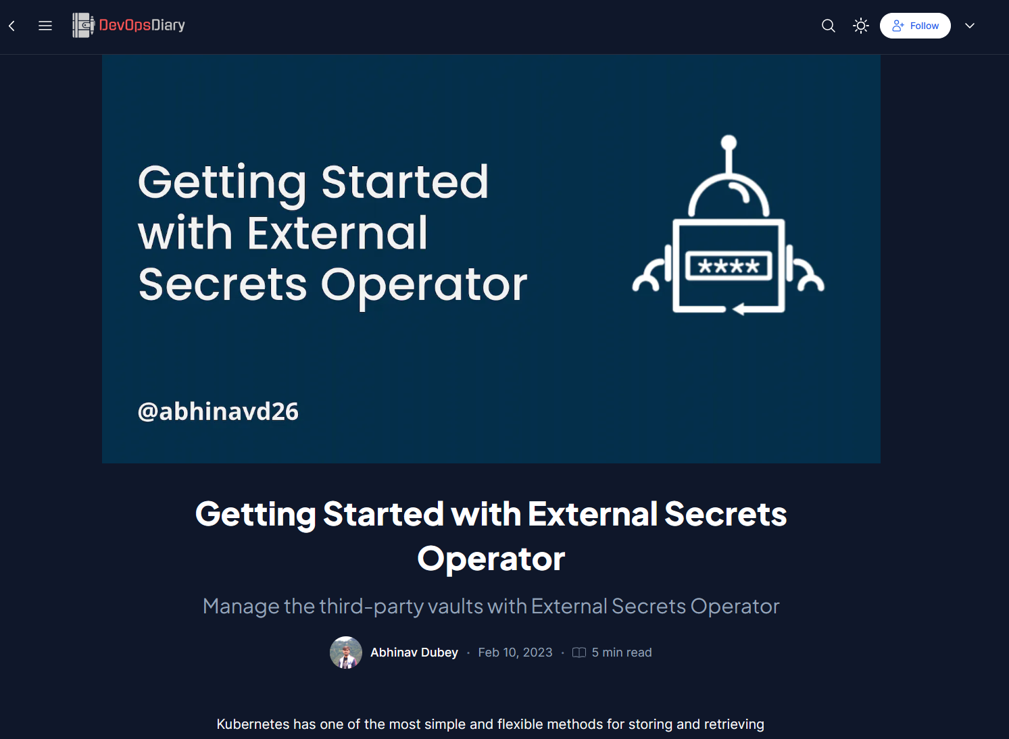
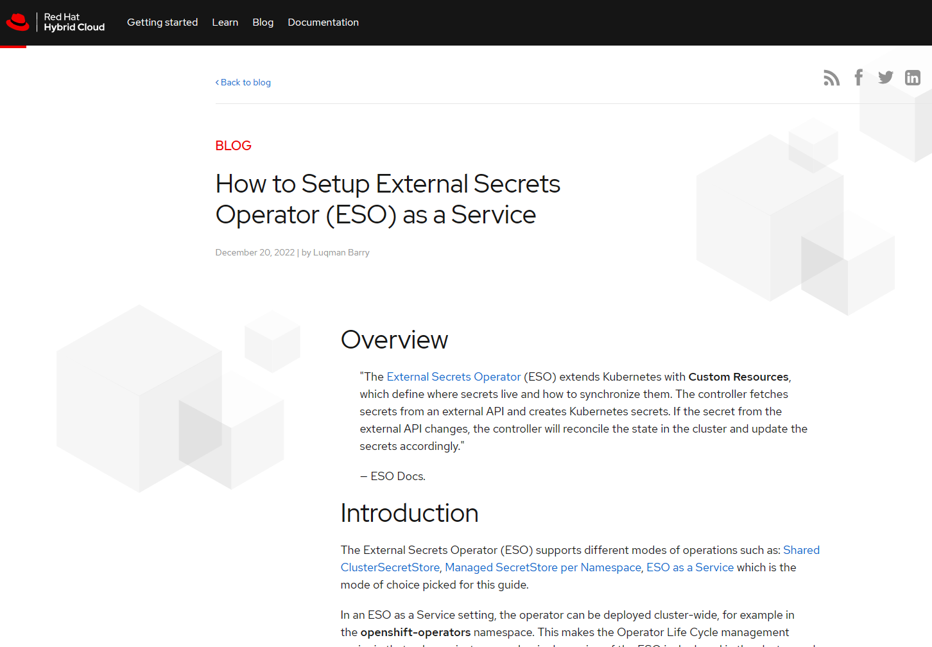
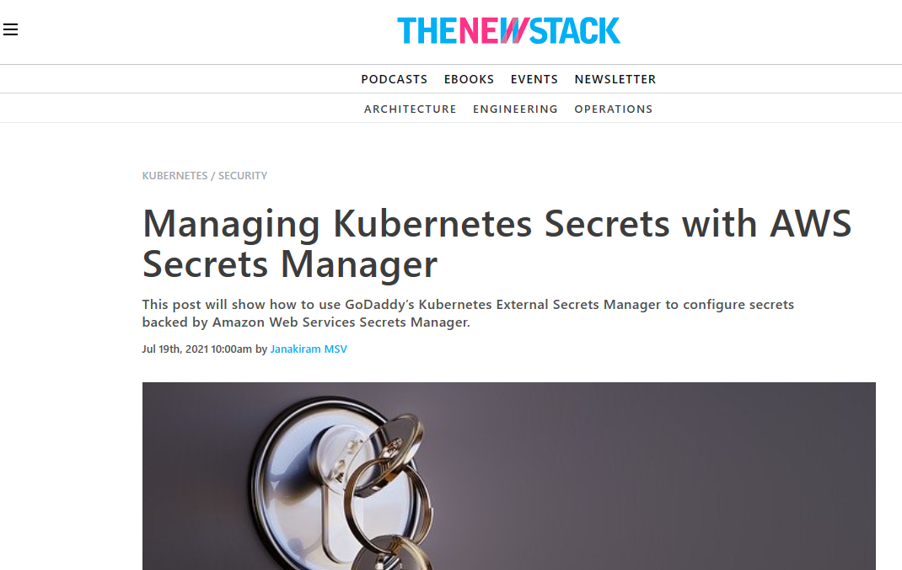
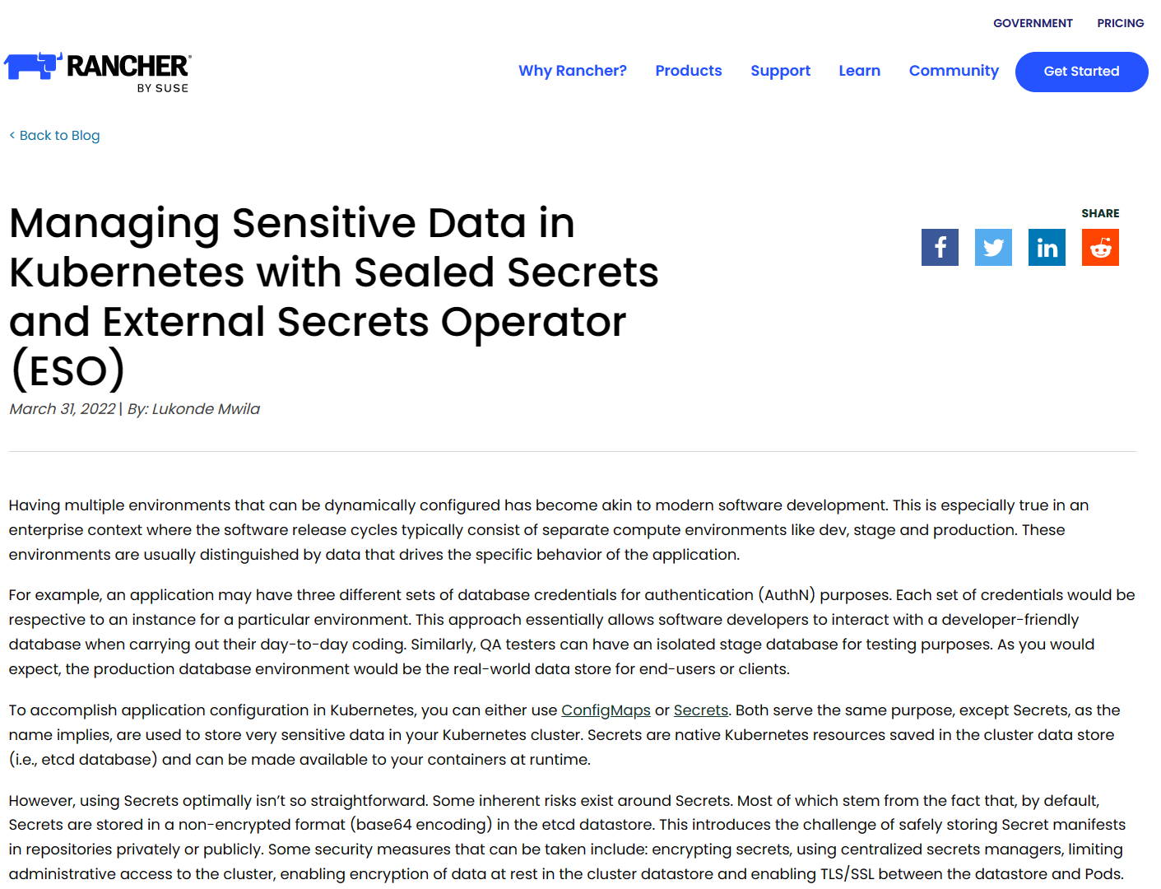
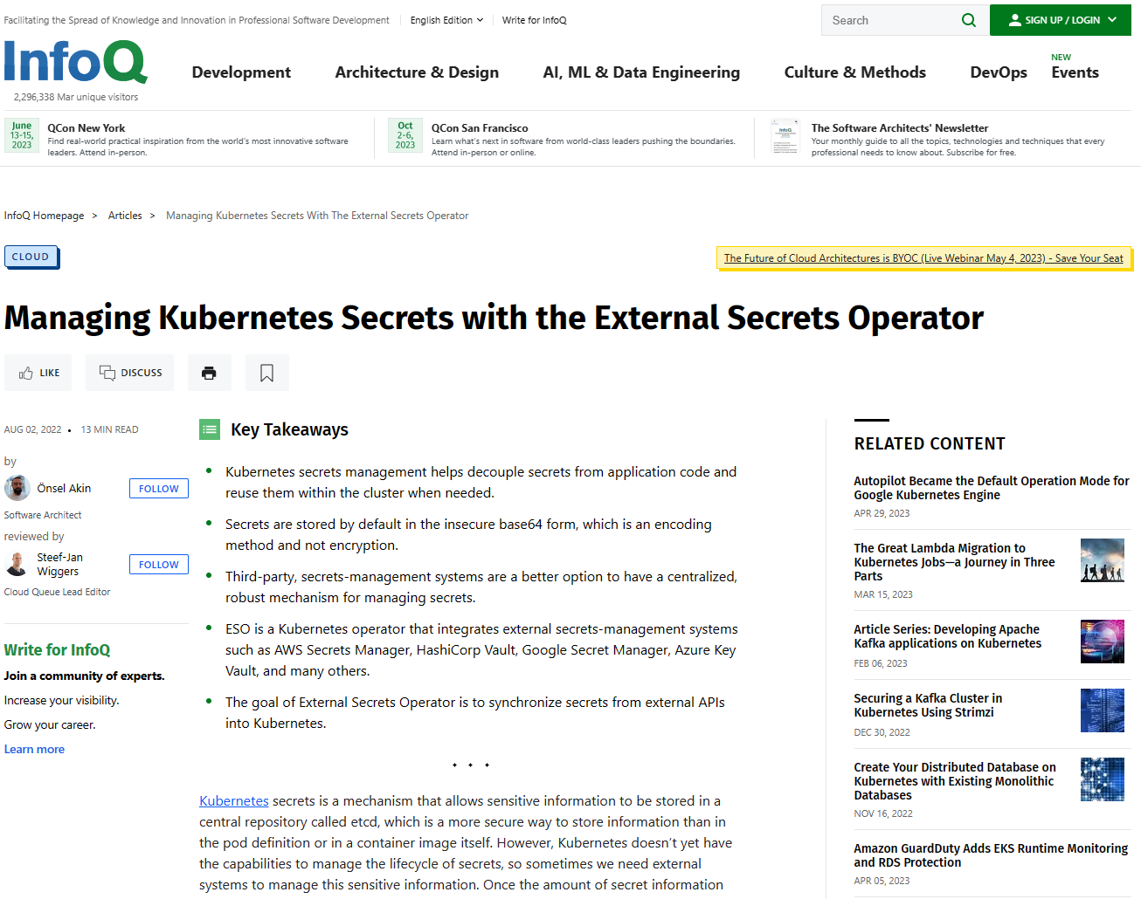
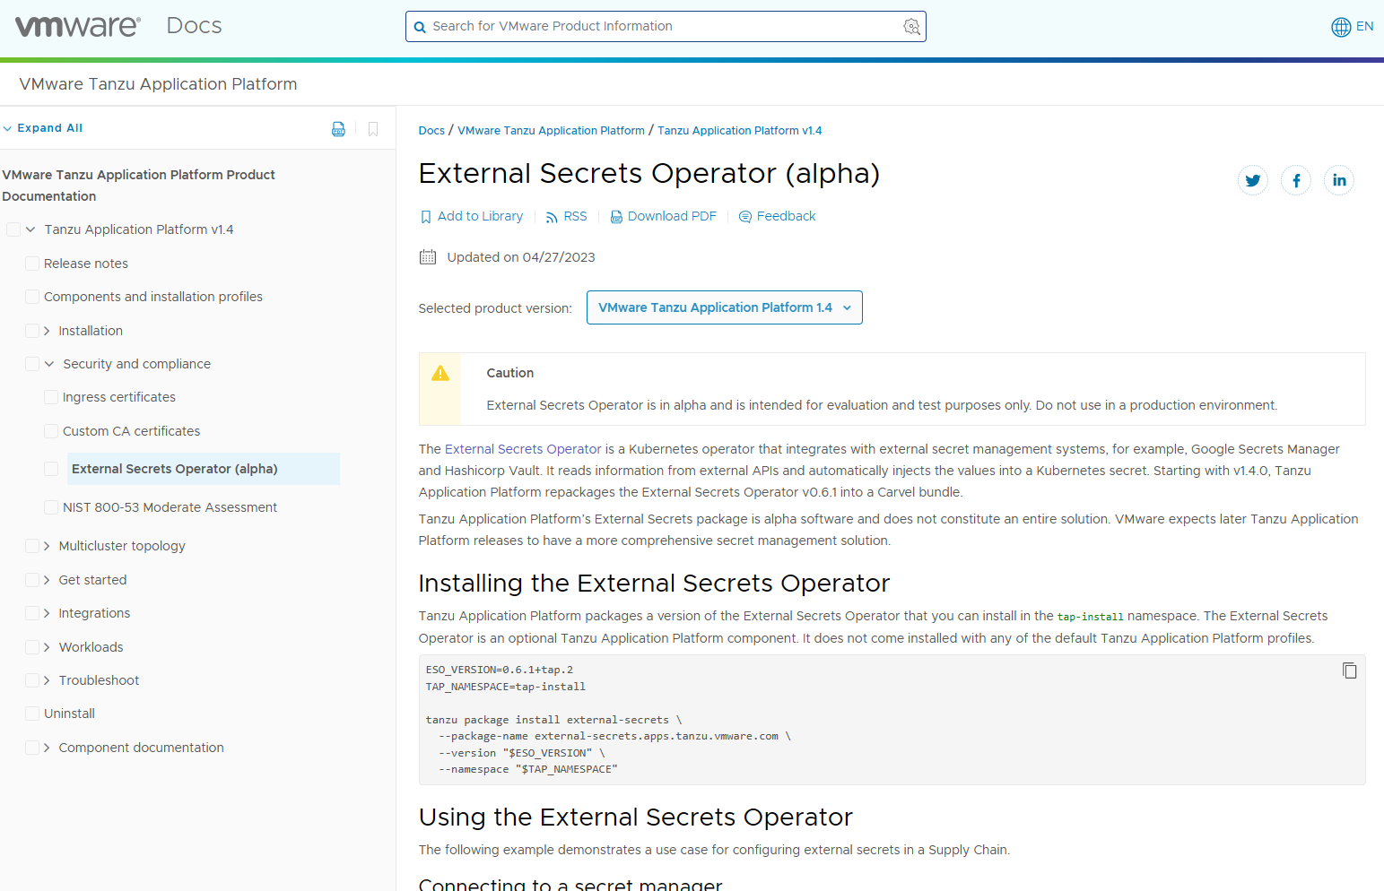
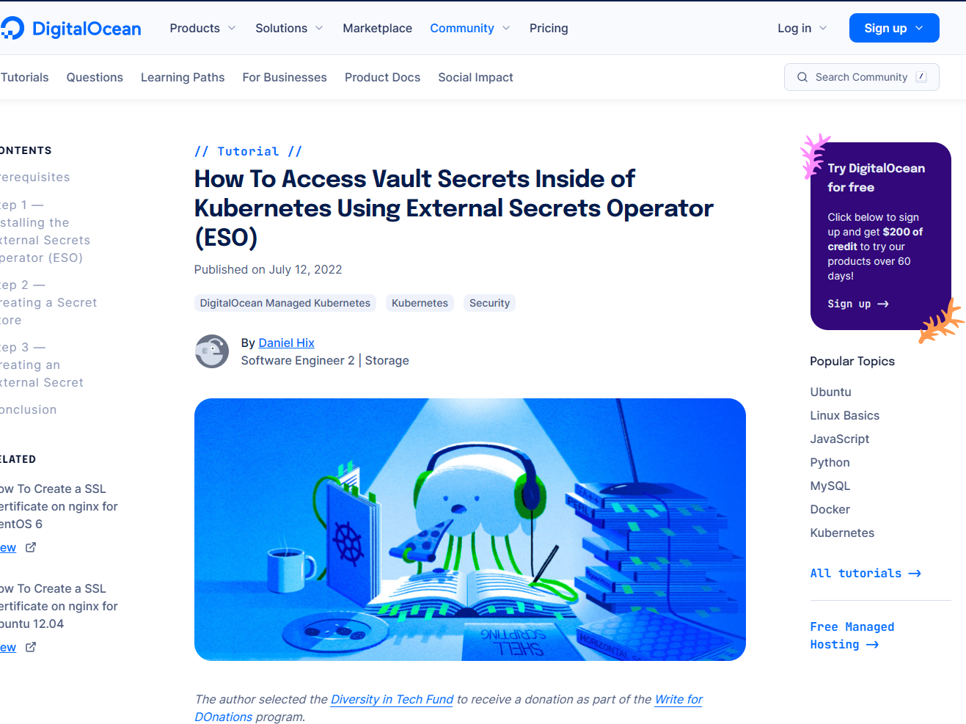
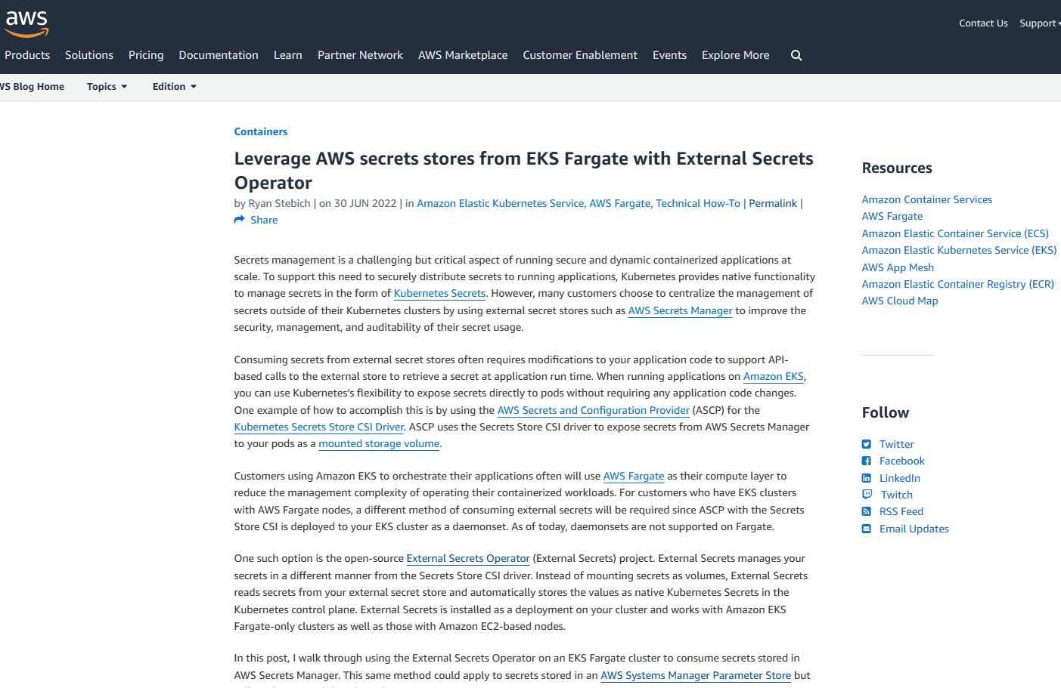

Slide 24
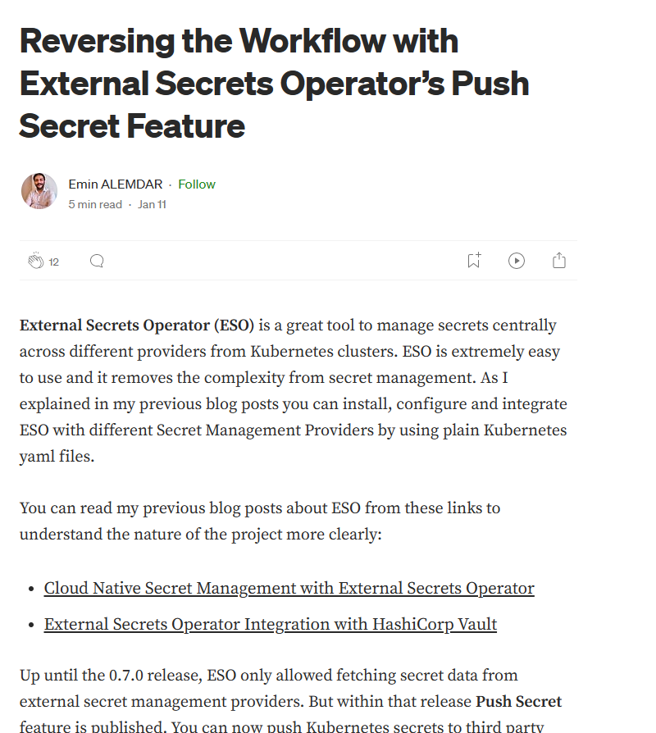
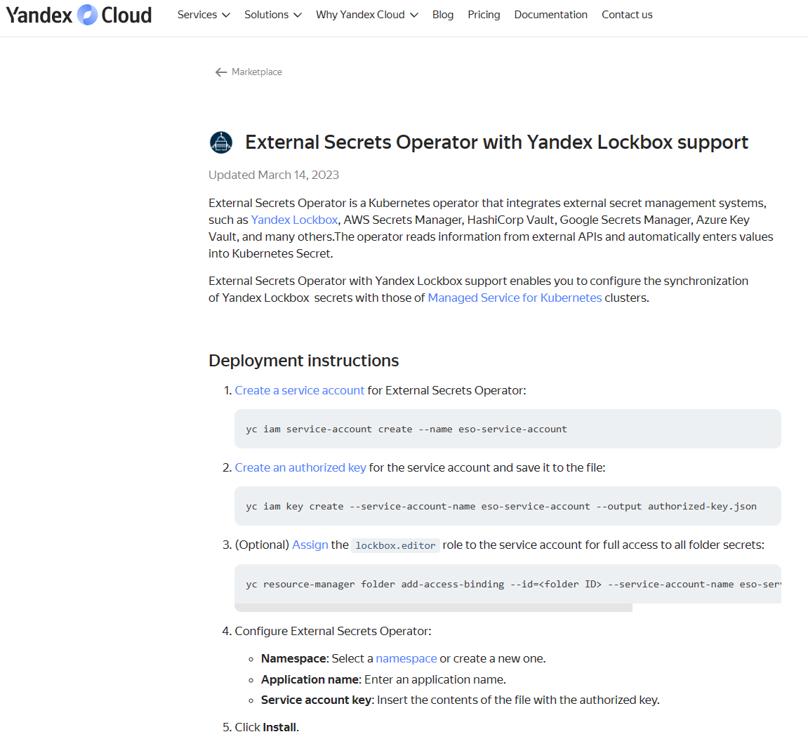
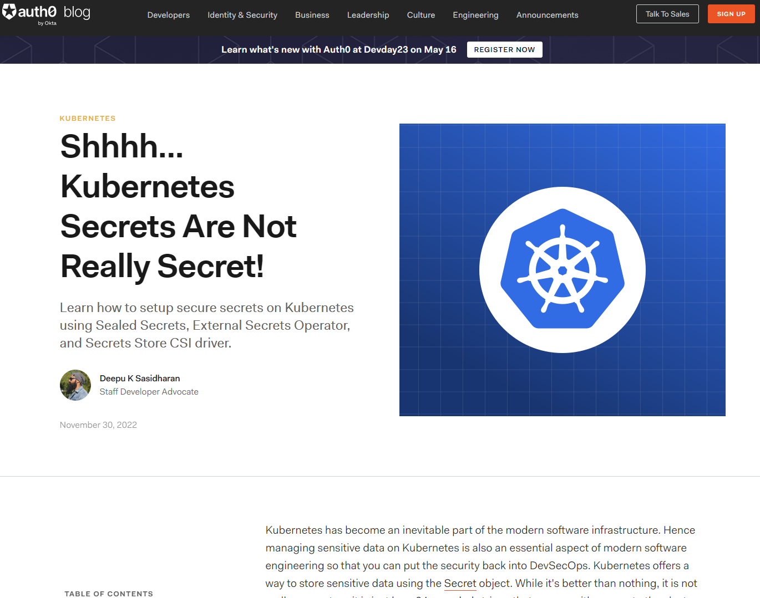
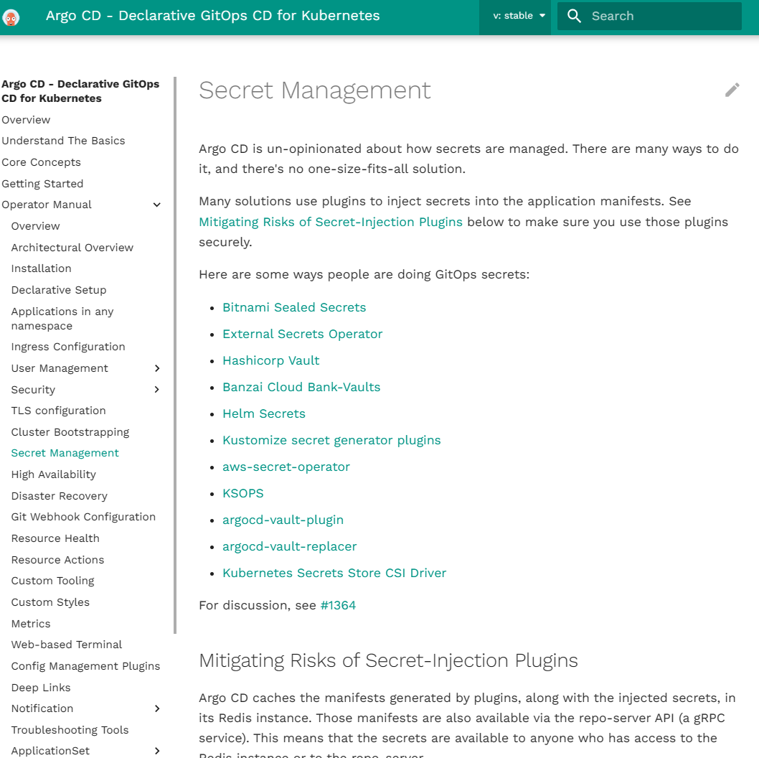
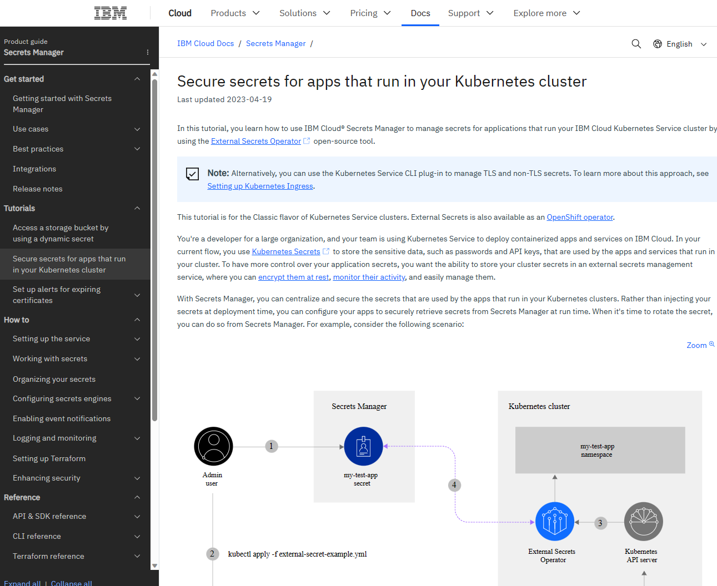
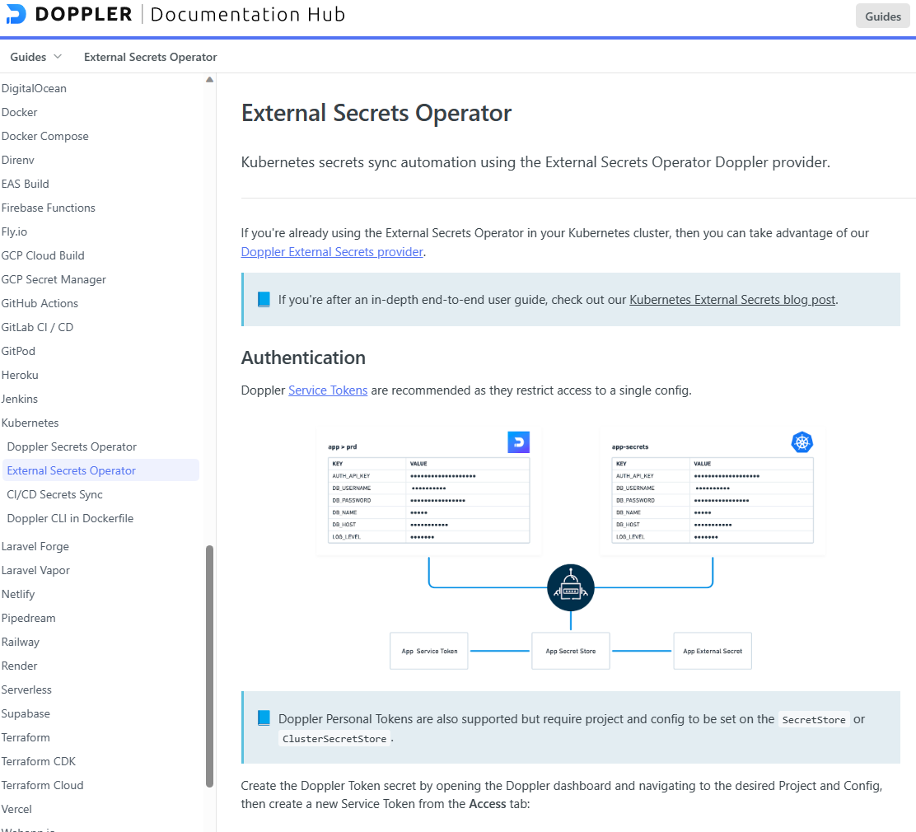

Slide 25
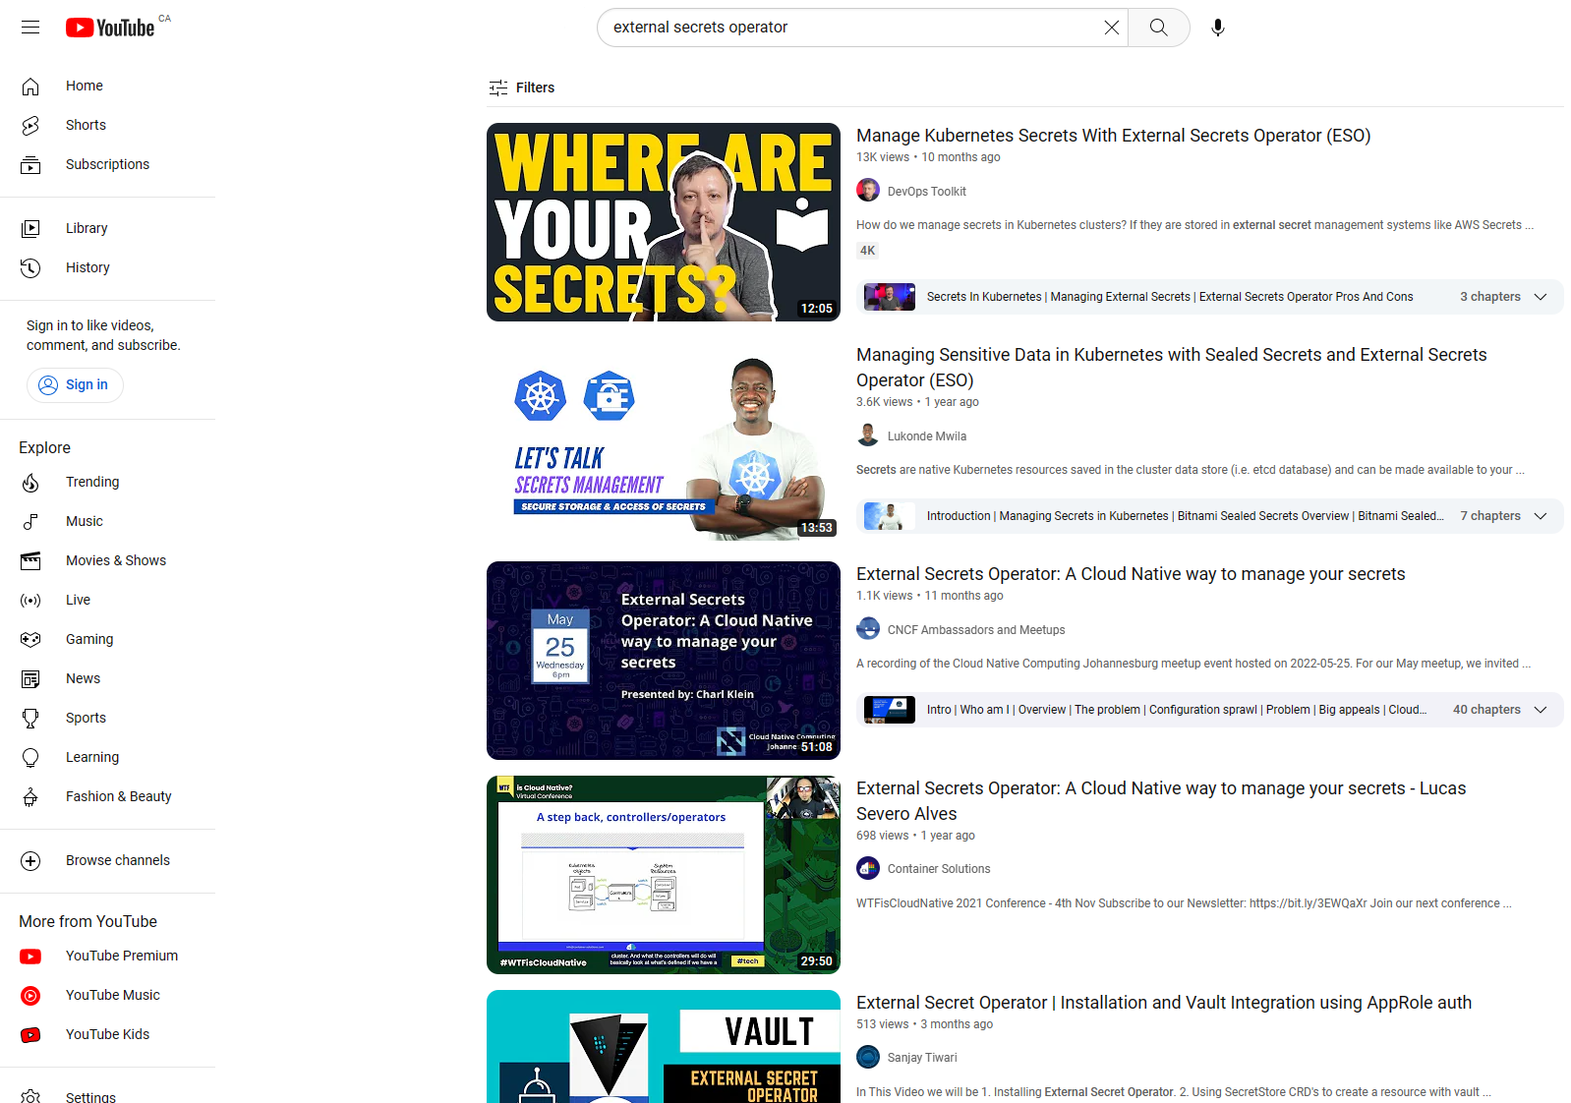
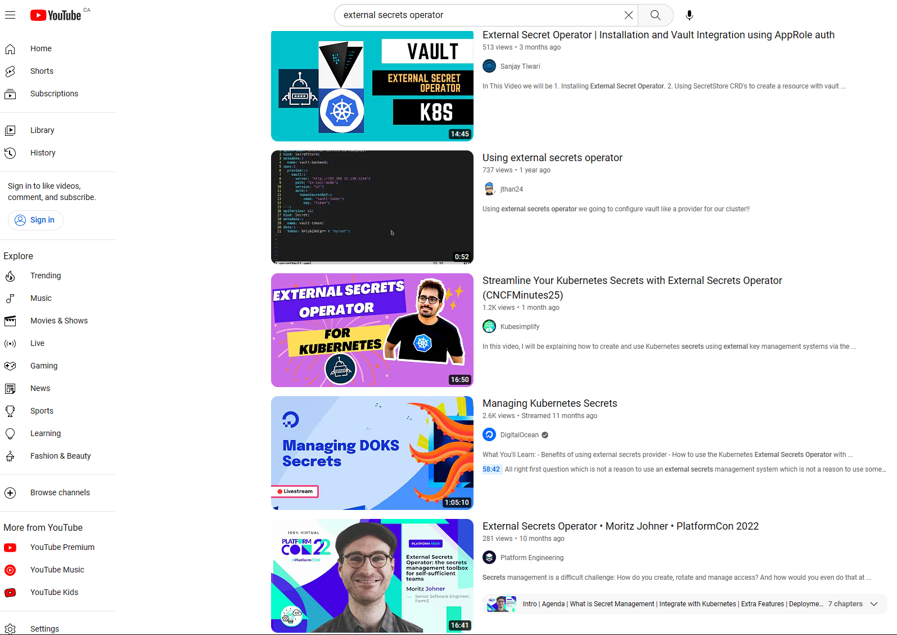
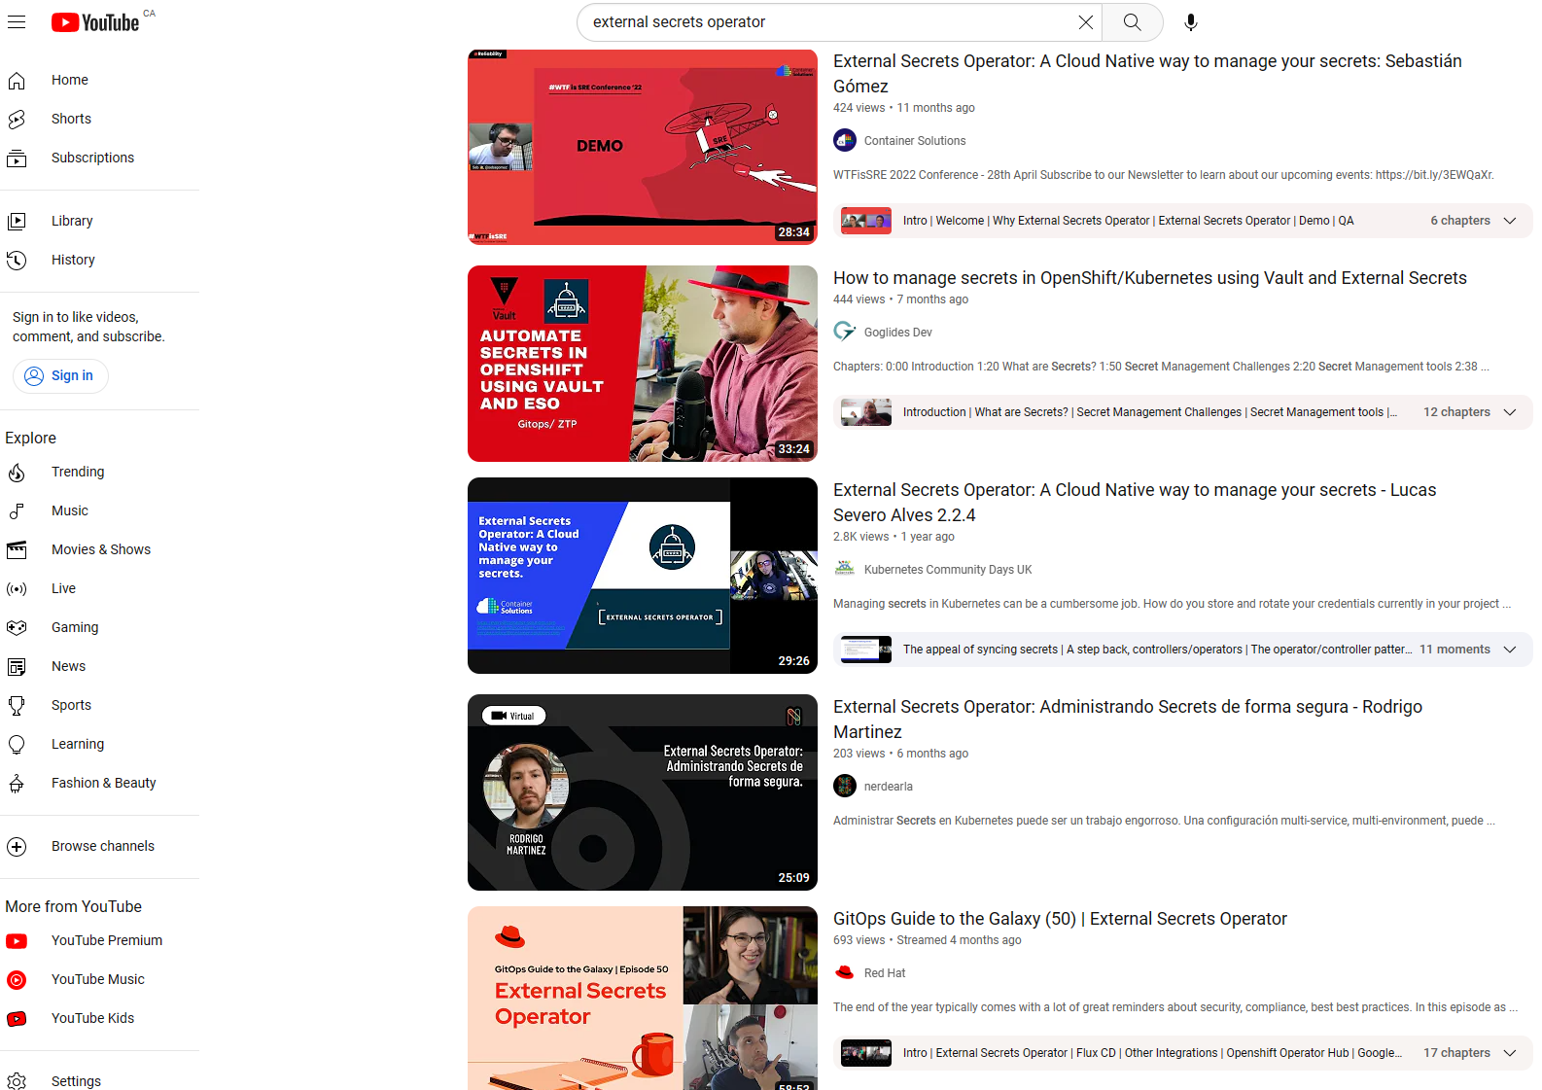
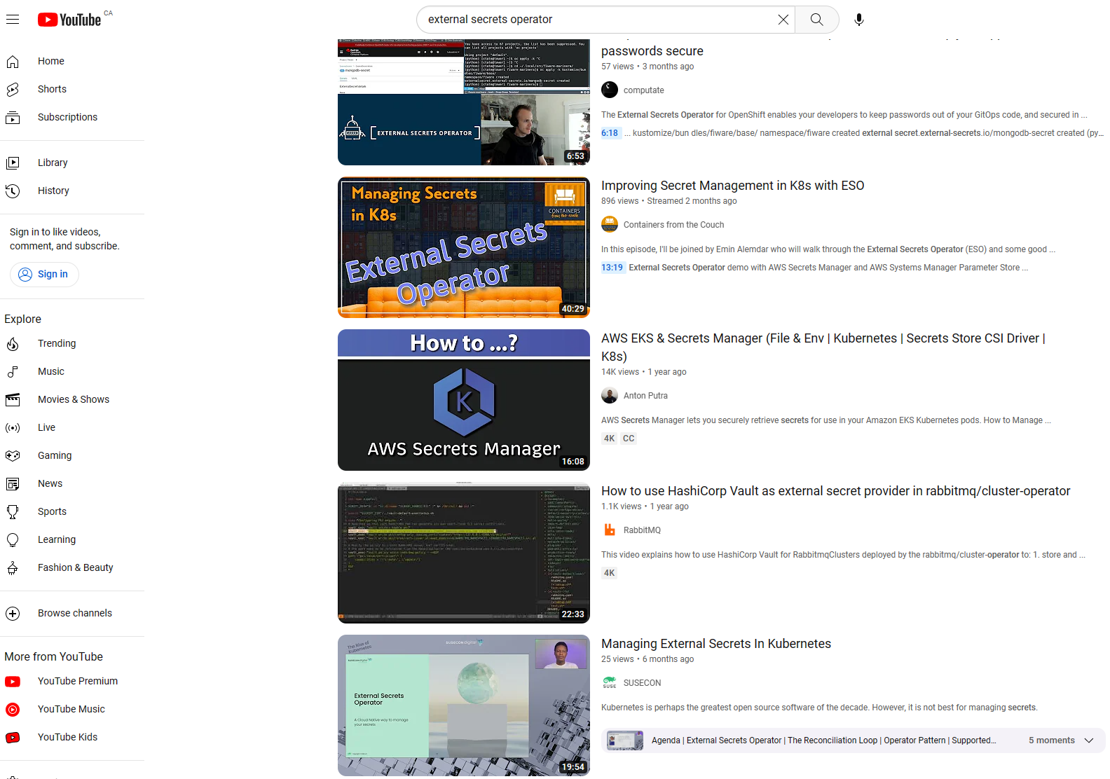

Slide 26
What’s next
Stabilize PushSecrets and Generators
More tests
More documentation
General availability: 2023 🤞
Contributors/Maintainers needed
Code (golang), testing, documentation
Hacktoberfest friendly
Good first issue tag
Sponsors needed

Slide 27
Resources 📸
Website: https://external-secrets.io/
Repo: https://github.com/external-secrets/external-secrets/
Community meetings:
Every other Wednesday at 2 pm (EST)
Agenda: https://hackmd.io/GSGEpTVdRZCP6LDxV3FHJA
YouTube: https://youtube.com/@external-secrets4810
Slack: https://kubernetes.slack.com/messages/external-secrets
Demo: http://github.com/sebagomez/eso-demo

Slide 28



One more thing! (shameless plug)
November 1-2
DevOpsDays.org/montreal
CFP open!

Slide 29
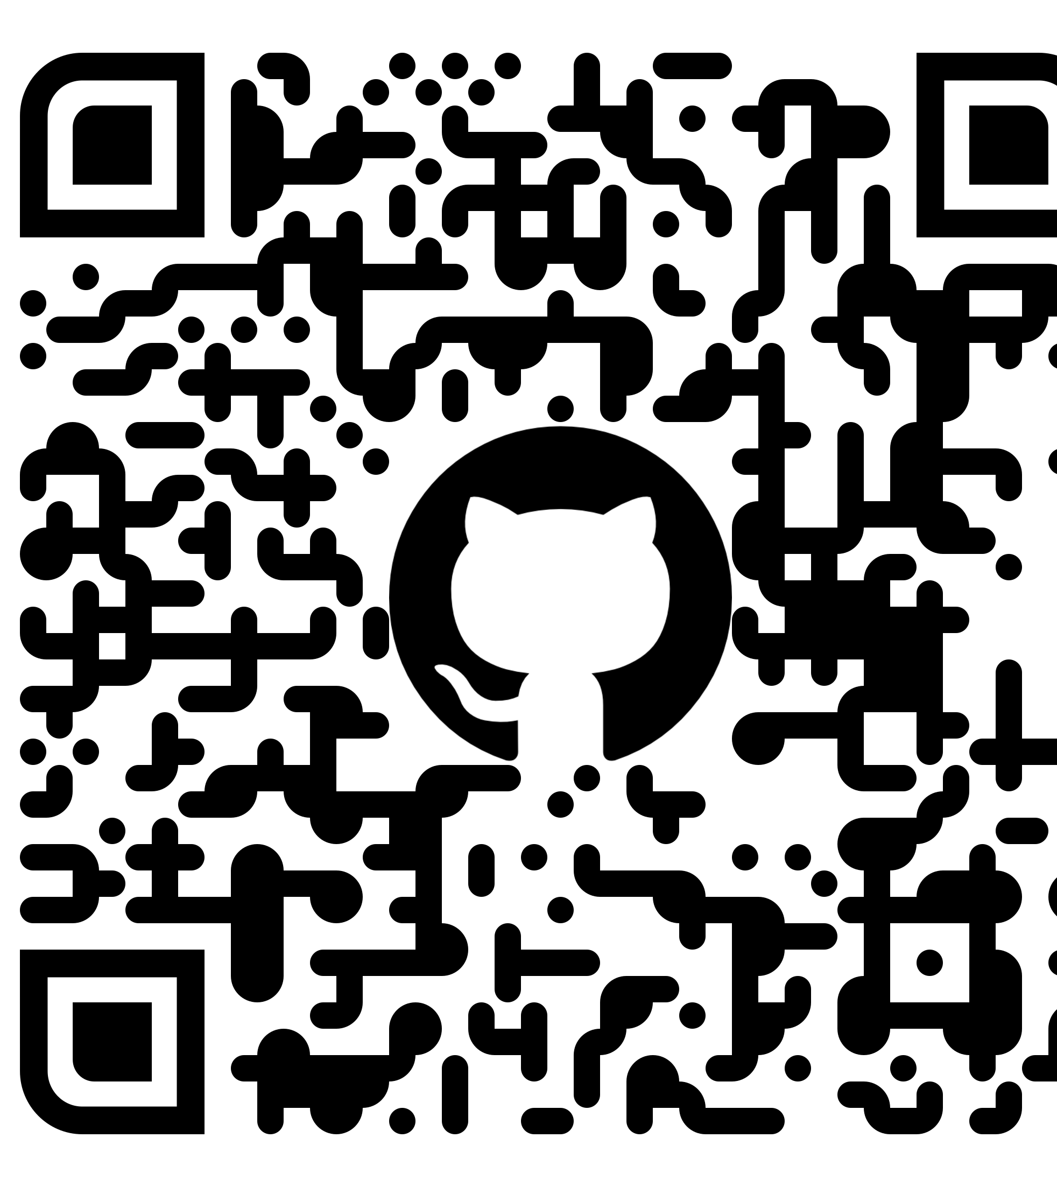
¡Muchas gracias!
@sebagomez

